Slide 1

SNAKE MIC
VEDANT DESAI
SMRITHI THUDI
TARUN THATHVIK

Slide 2
PROBLEM STATEMENT
A Mic-like structure that is supposed to be able to move around in an auditorium during a desired event with less than heavy tail of a wire, in a snake-like fashion. Additionally, this mic needs to have a Bose Speaker inside, to play any desired sound while during the performance.

Slide 3




THINGS CONSIDERED
Unlike a typical product, our product has a one specific customer. So this narrows the scope of the research by a great deal.
Void of any additional details or features to the product, it has to perform every job and only the given job.
This product can be operated by anyone, so it needed a user friendly interface.

Slide 4
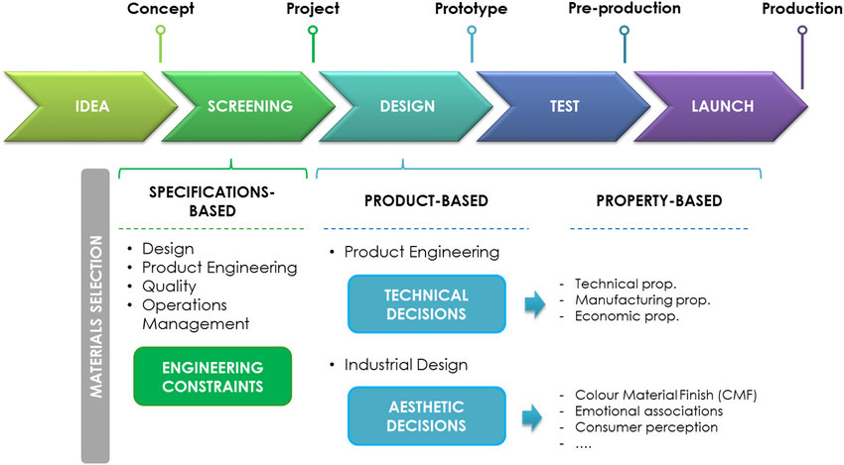
TYPICAL PROCESS OF PRODUCT DESIGN
Notes:
This image

Slide 5


DESIGN CHALLENGES
Aesthetics
Size Factor
Notes:
We mention about the fact that we used arduino nano for this reason

Slide 6
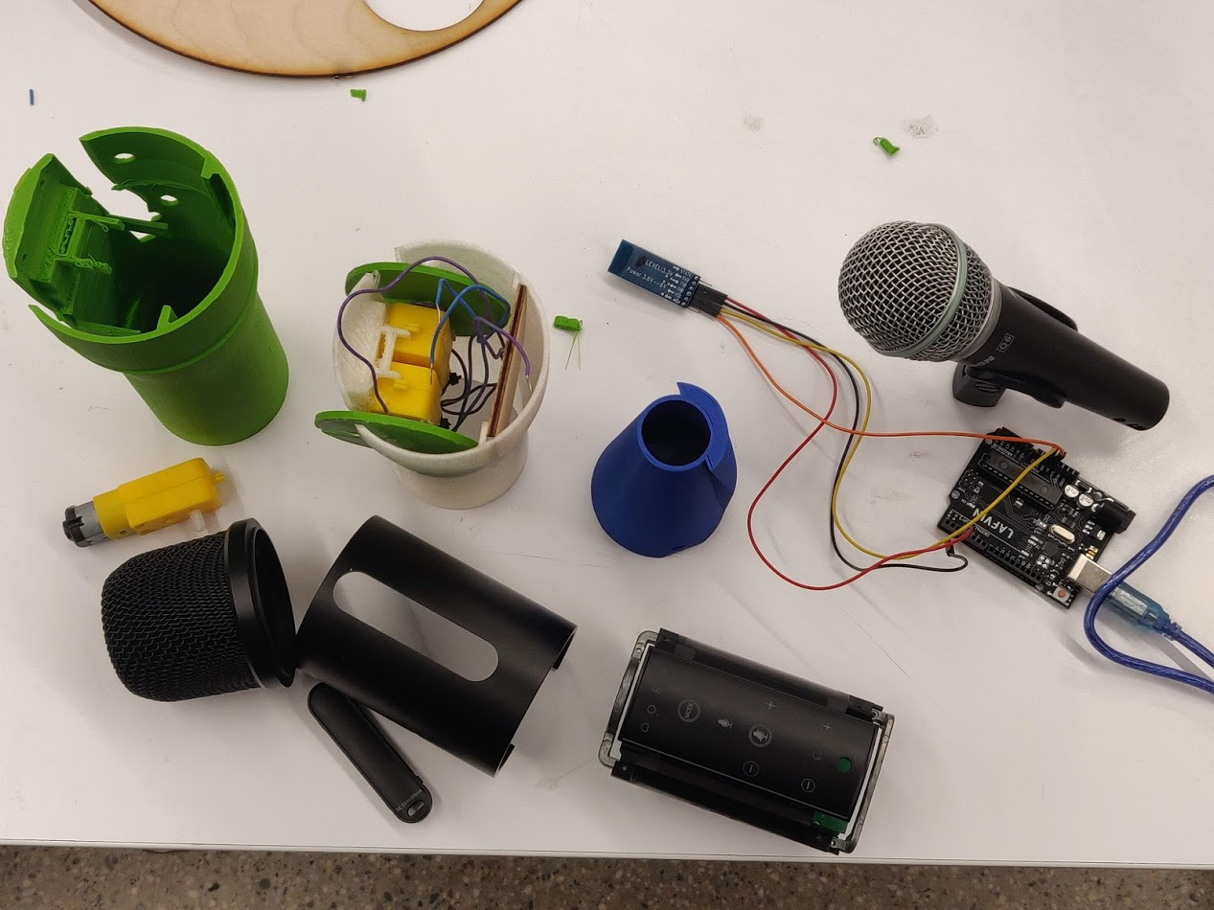
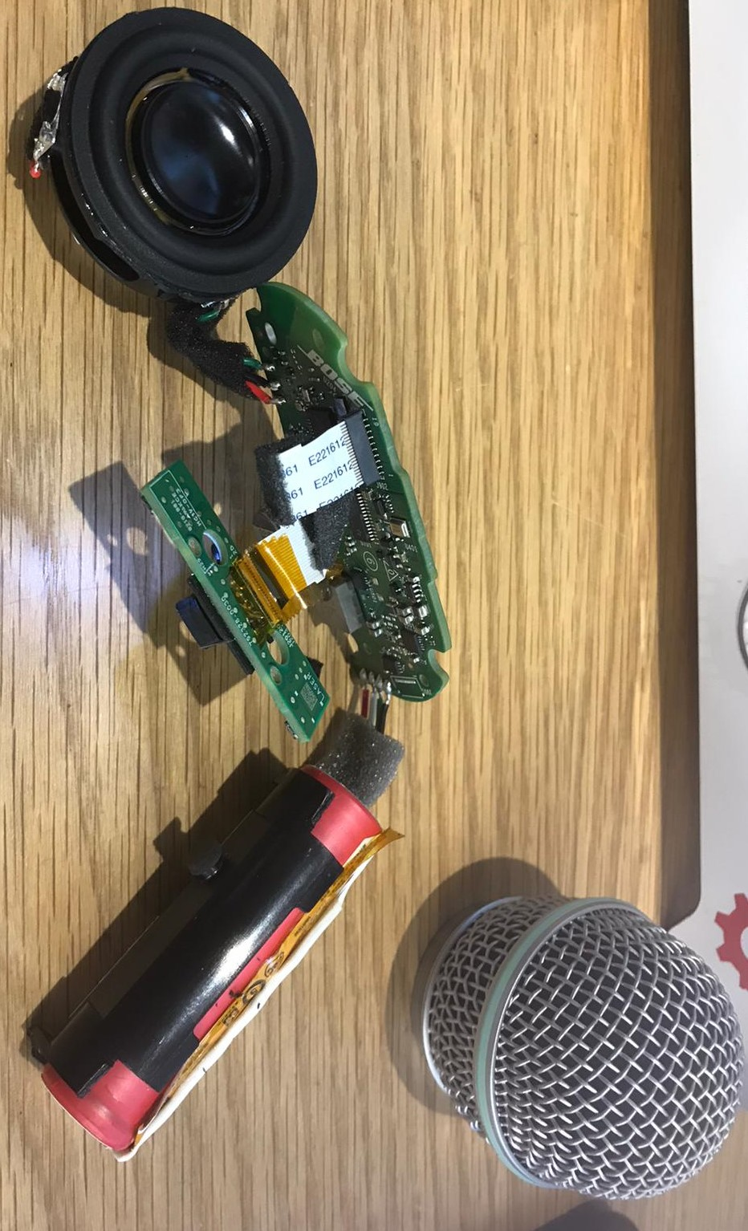
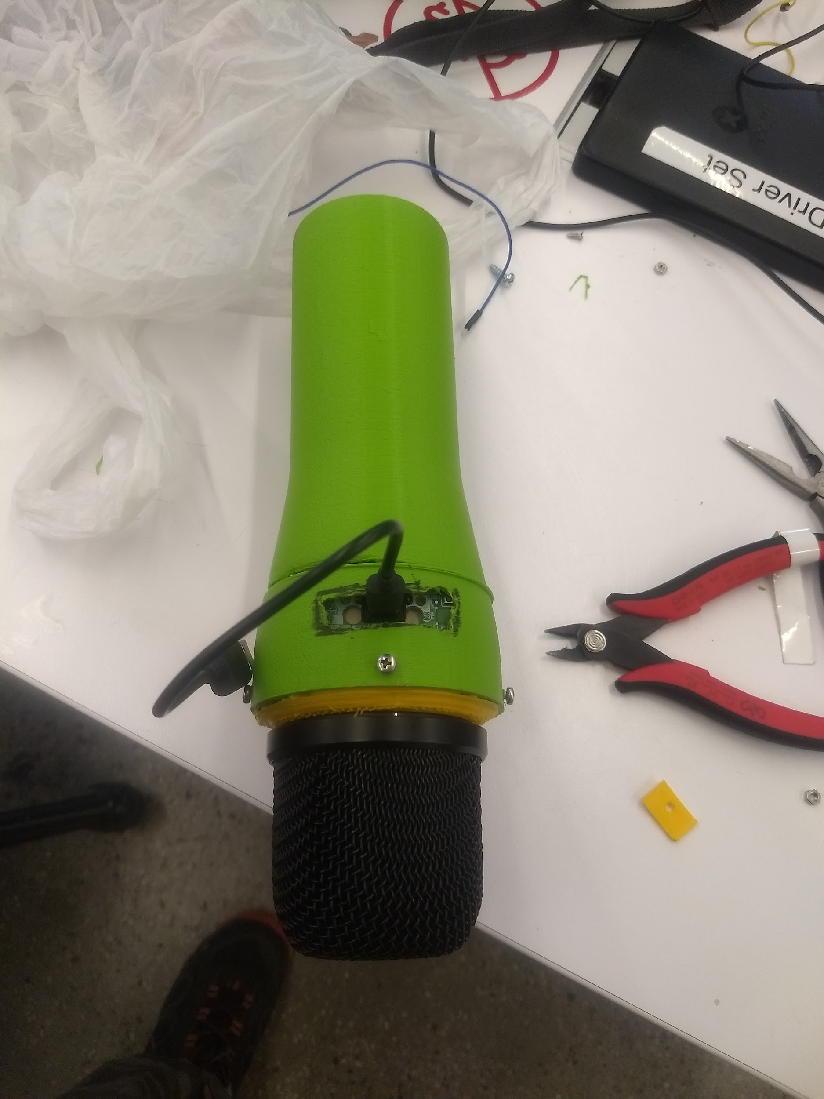

Slide 7
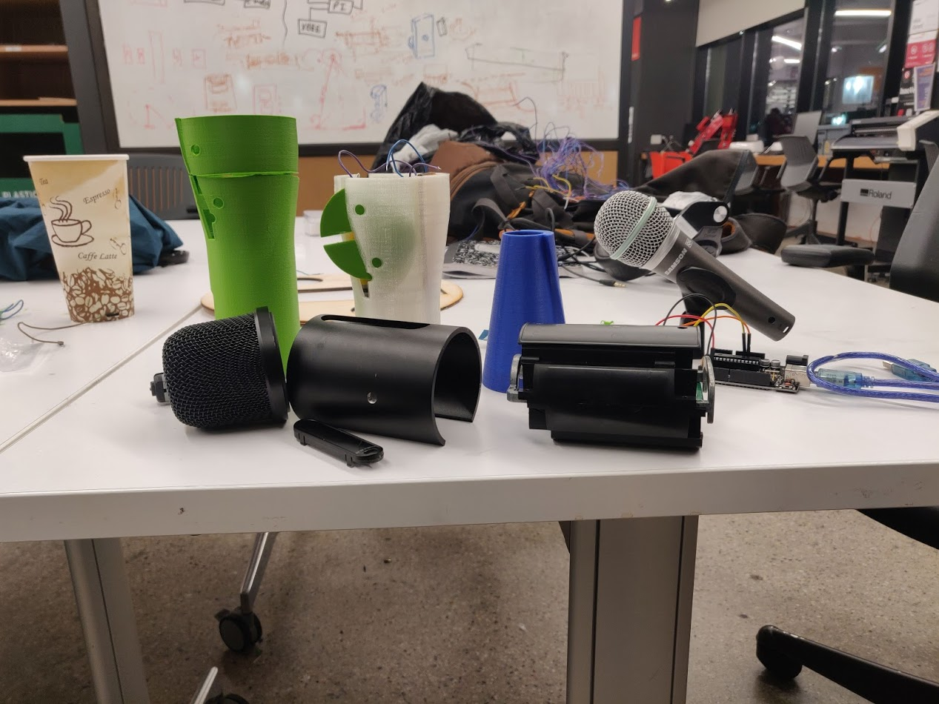
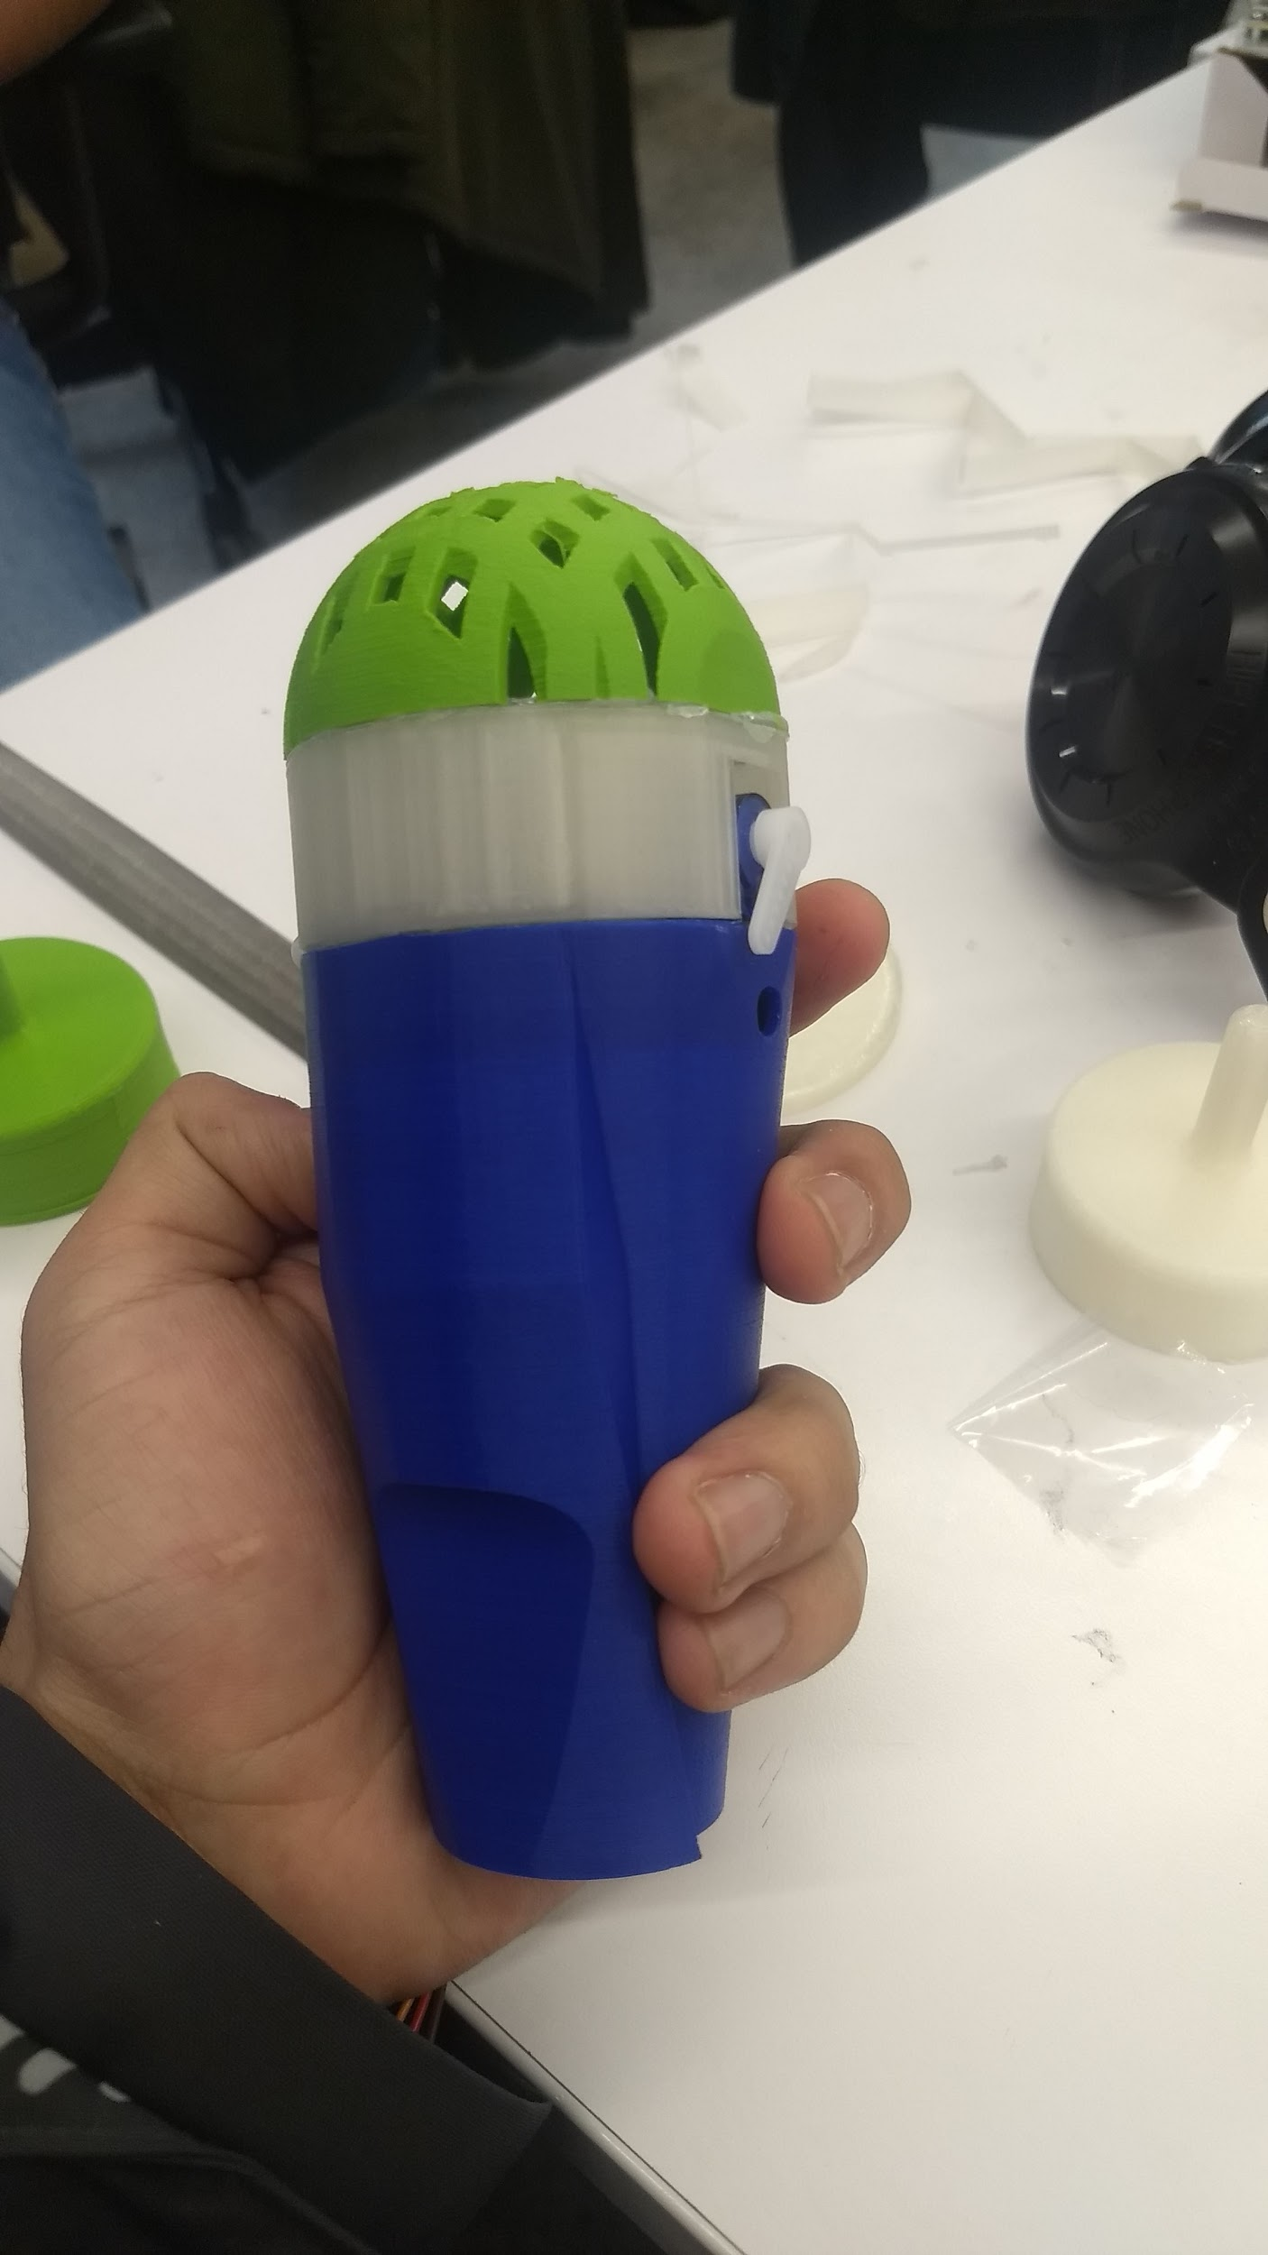
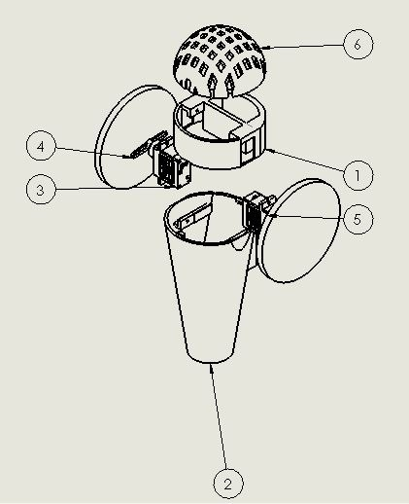
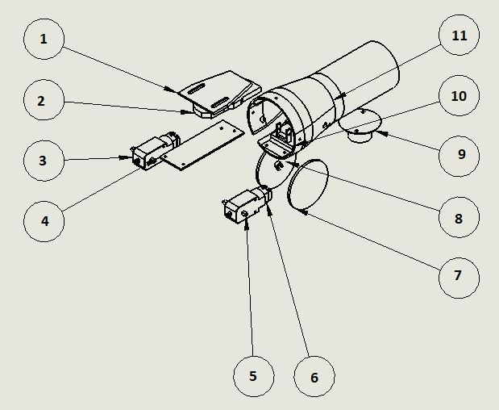
Build
Test
Design

Slide 8
FIRST ITERATION
Size focused model
3D printed mesh.
Fit only the electronics to make the mic move.
Doesn’t meet the aesthetic requirements.

Slide 9
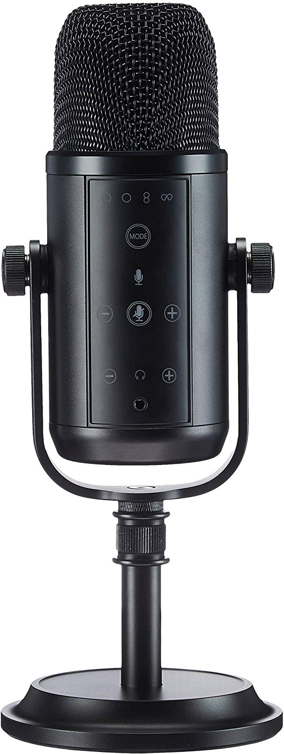
SECOND ITERATION
Improvements
Increased the size
Used the mesh from a large Mic
Changed the look completely
Test
New DC motors
Assembly
Differential drive
Aesthetic look
Results (future improvements)
Make simpler assembly
Add charging slot

Slide 10
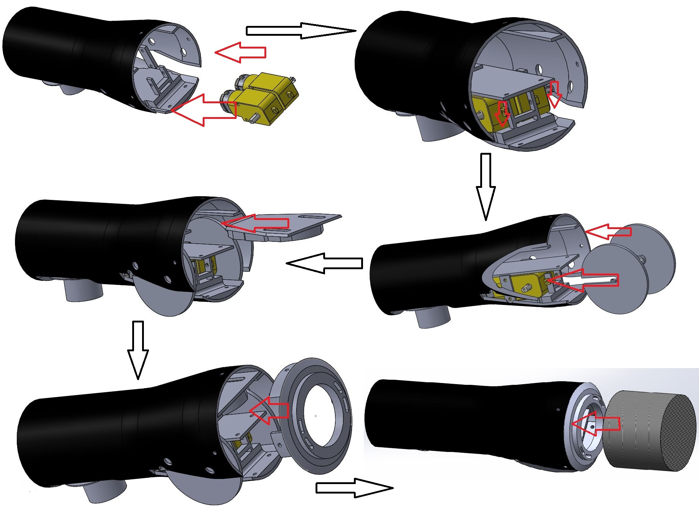
ASSEMBLY

Slide 11
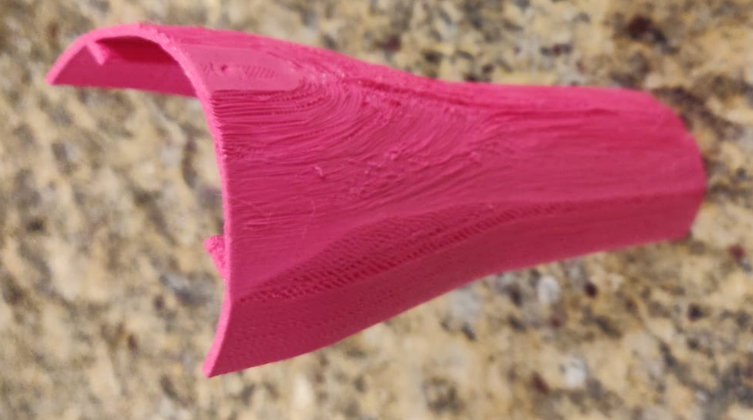
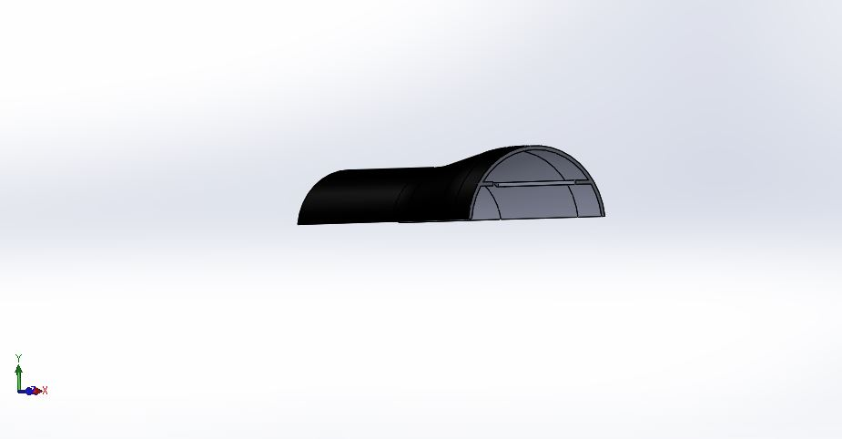
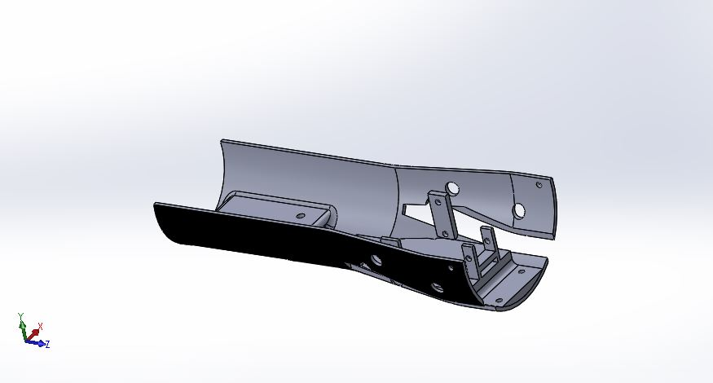
THIRD ITERATION
Improvements :
To make assembly simpler, the design was cut in half
Main Problem:
The body of the model was too weak

Slide 12
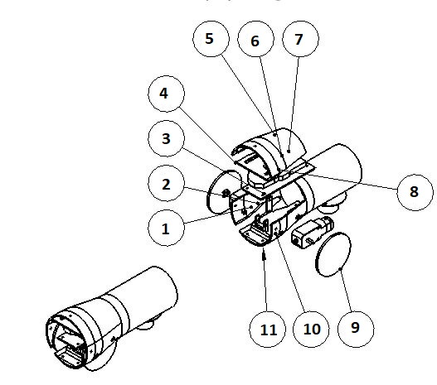
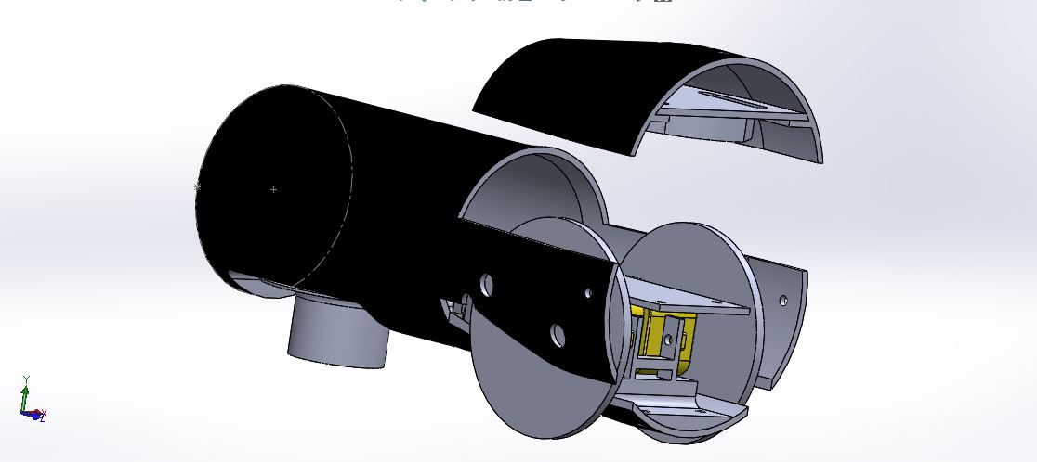
FINAL ITERATION (MECHANICAL DESIGN)

Slide 14
COMPONENTS
Mechanical:
3D printed shell
Microphone Mesh
Wooden Wheels
Caster Wheel
Electronics:
DC motor
L293D Motor Driver
Arduino Nano
Joystick (For testing and building code)
Bluetooth module (HC05)
Bose SoundLink Micro Speaker

Slide 15
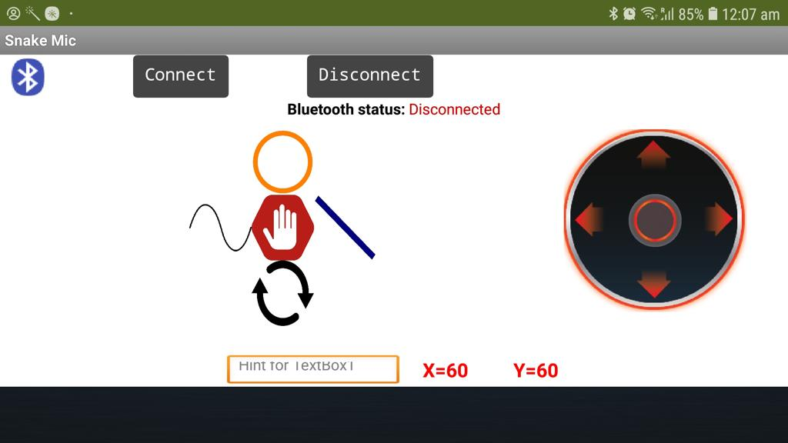
USER FRIENDLY INTERFACE
An Android App

Slide 16
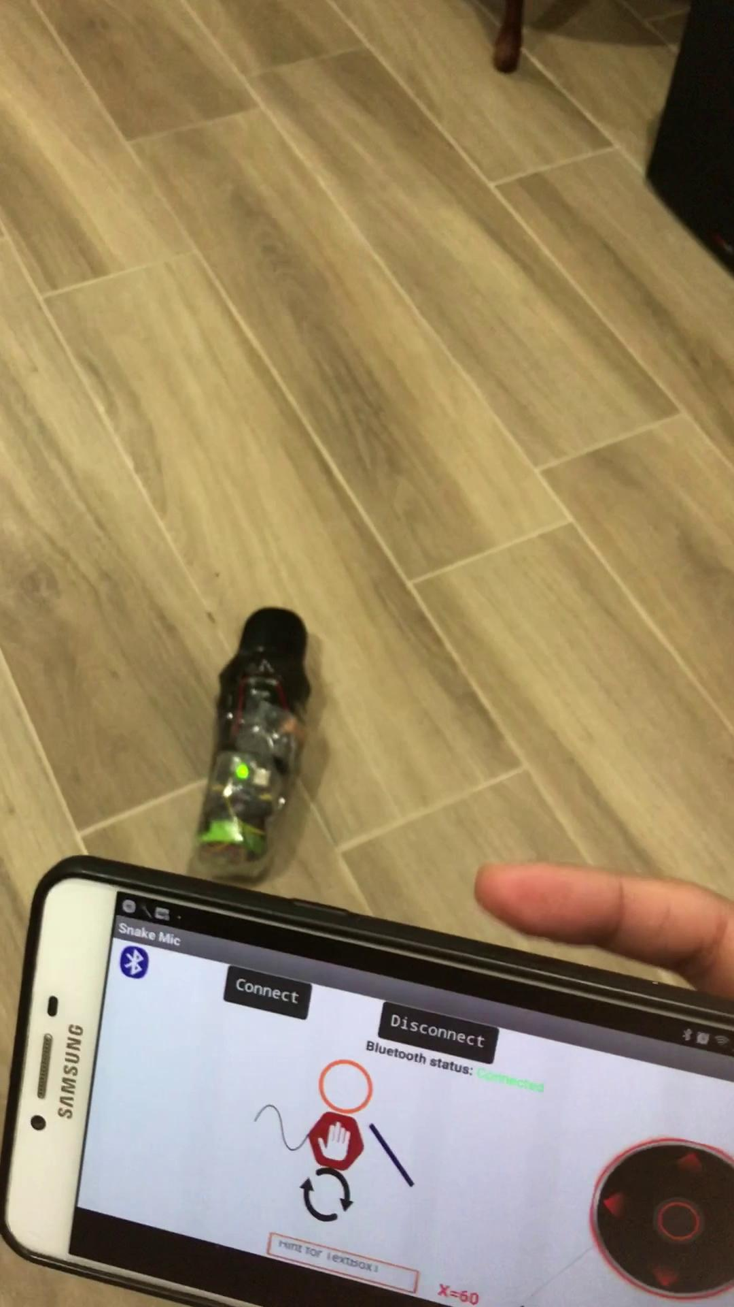

Slide 17
THANK YOU

